Slide 1
Microservices and DevOps
DevOps and Container Technology
Virtualization
Henrik Bærbak Christensen

Slide 2

What is it?
vir•tu•al (adj):
existing in essence or effect, though not in actual fact
Example
ScummVM is a program which allows you to run certain classic graphical point-and-click adventure games, provided you already have their data files. The clever part about this: ScummVM just replaces the executables shipped with the games, allowing you to play them on systems for which they were never designed!

Slide 3
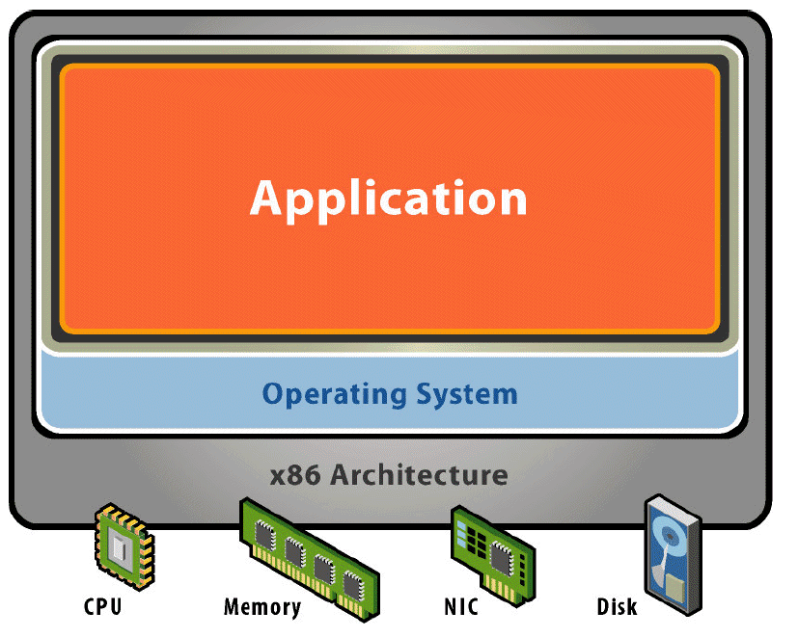
A Physical Machine
Hardware
Processors, devices, memory, etc.
Software
Built to the given hardware (Instruction Set Architecture, e.g. x86)
Built to given OS (App. Programming Interface, e.g. Win XP)
OS controls hardware

Slide 4
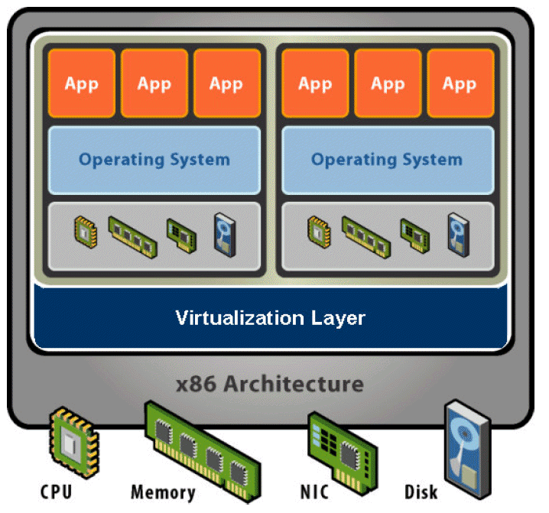
A Virtual Machine
Hardware Abstraction
Virtual processor, memory, devices, etc.
Virtualization Software
Indirection: Decouple hardware and OS
Multiplex physical hardware across guest VMs

Slide 5
Smith et al.
API: Library calls
Appl Progr Interface
ABI: OS calls
Appl Binary Interface
ISA: Machine Code
Kernel Mode

Slide 6
Why VMs?
Many advantages (often business related)
Utilization of resources
VM1 that idles automatically free resources to VM2
Of course not the case for physical machines
Isolation
Crash, virus, in VM1 does not propagate to VM2
Encapsulation
A VM is a file: (OS ,Apps, Data, Config, run-time state)
Content distribution: Demos as snapshots
Snapshot provides recovery point
Migration to new physical machines by snapshot/restore
In e.g. server farms

Slide 7
Why VMs?
More advantages
Maintenance costs
Maintain 100 Linux-based web server machines versus a few big VM platforms
Legacy VMs
Run ancient apps (like DOS or Win98 programs)
Create once, run anywhere
No configuration issues
E.g. complex setup of app suite of database, servers, etc.

Slide 8
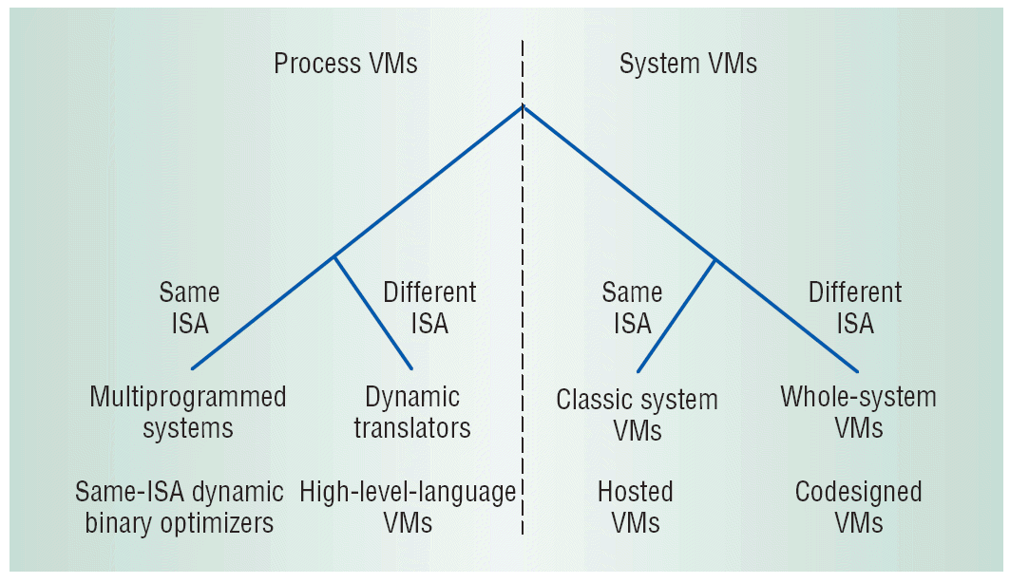
Types of VMs
Smith & Nair 2005
Two super classes
Process VM
System VM
Both can be sub classed based upon supporting virtualization of same or different ISA (Instruction Set Architecture).

Slide 9
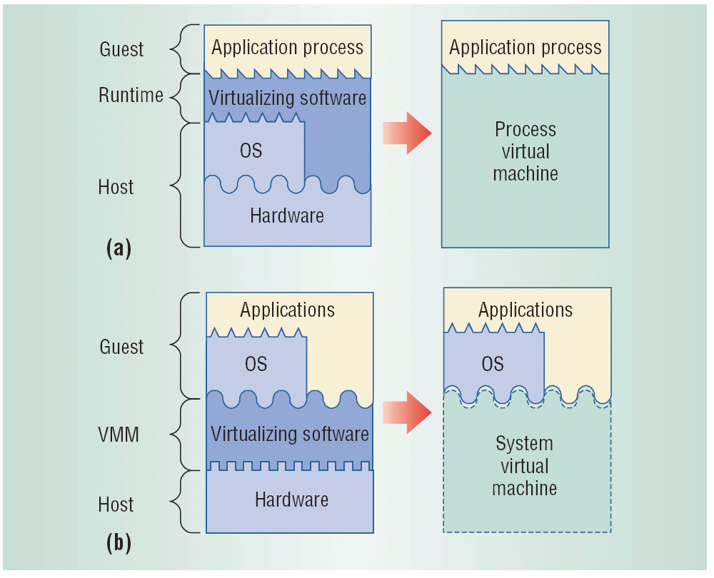
Process / System VM

Slide 10
Process VM
The process VM puts the virtualization border line at the process line.
A application process/program executes in a
Logical address space (assigned/handled by the OS)
Using user-level instructions and registers (CPU user-mode)
Only do IO using OS calls or High-Level Library(HHL) calls
Thus a process VM becomes a virtual OS in which a process may execute.
Example: Different ISA Process VM
JavaVM defines its own ISA (stack-based) as well as normal OS operations

Slide 11
System VM
The system VM sets the virtualization border at the system or hardware line
A system/OS executes in a
Physical memory space
Using the full ISA of the underlying machine
Interact directly with IO
Thus a system VM becomes a virtual machine in which a system as a whole may execute
Example: Same ISA System VM
VMWare: Executes Guest OS that is running on the x86 ISA.

Slide 12
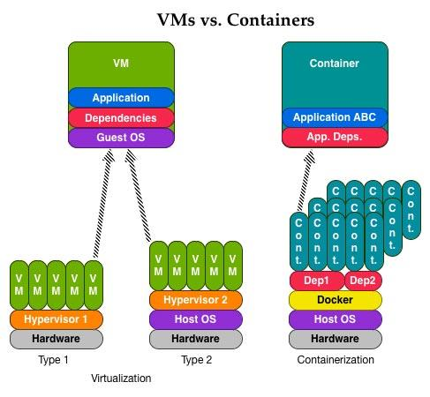
OS Level VM
OS-Layer Virtualization (Sahoo, 2010), or
Operating System Level virtualization
Merkel (2014)
Ex:
Docker

Slide 13
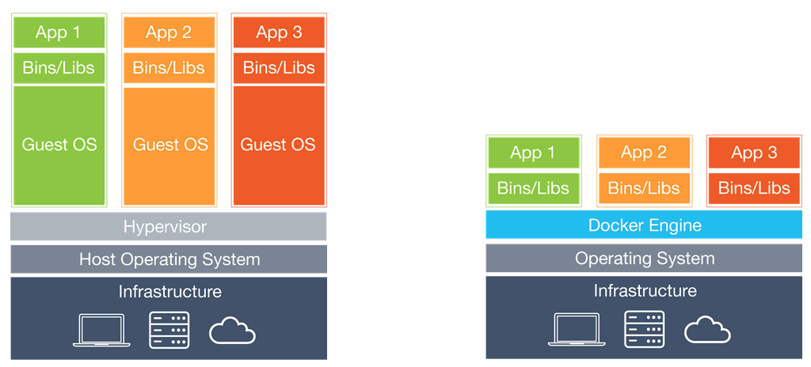
Or…
From Docker
Traditional VMMs
Docker

Slide 14
Classic Versus Hosted VMs
Hosted
VMWare Player (free) / Workstation Pro
Ordinary application in Linux/Windows
Classic (Bare metal)
VMWare ESXi (free of charge!)
Runs on the bare machine using a minimal Linux core

Slide 15
Examples

Slide 16
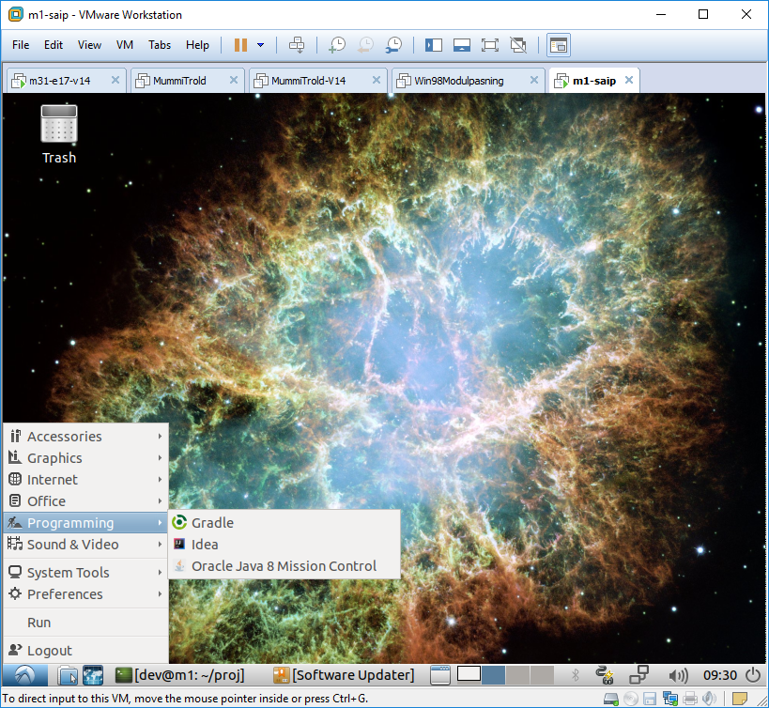
Packages for Students
For my course, I hand out a dedicated VM
Faster ‘get going’

Slide 17
Avoid Poluted Machine
The last couple of years I have removed code development from my laptop completely...
I only develop using my M1, M17, ... Virtual linux machines on my VMWare Workstation or on my ESXi hypervisors
One machine per course
Easier to switch
No polution of my laptop

Slide 18
Moving Production
Crunch3 machine was the production machine to do awesome stuff in another course I am running
It runs on my local ESXI
But, but – our students could not see it!
Moved to the AUIT vSphere infrastructure
VMWare converter…
Crunch3 is highly disk IO sensitive
Staff moved it ‘as we spoke’ to a pure SSD hypervisor

Slide 19
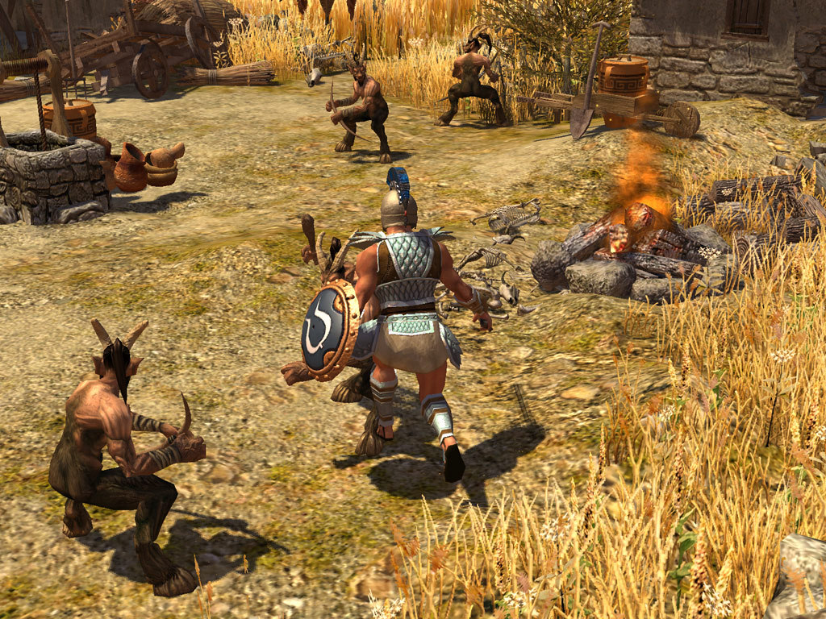
Keep Legacy Running
Magnus wants to play Titan Quest
On his new MSI Windows 10 gaming laptop
Titan Quest does not run on Win10
Solution: Win XP SP3 installed on VMWare Player
And then Steam released Titan Quest updated to run Win10 ☺

Slide 20
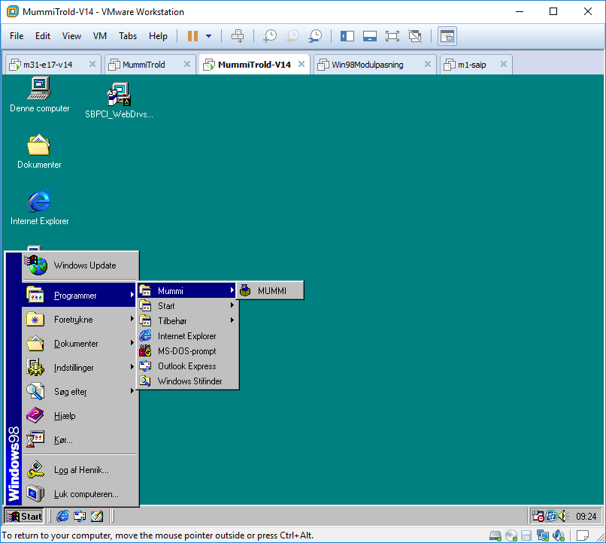
Keep Legacy Running
My company’s accounting system, SummaSummerum, is a legacy system, unsupported and cannot be reinstalled due to license server has been shut down.
I managed to pull license files from my company machine, and ”save it” in a VM. It is called ”TheArk” ☺

Slide 21
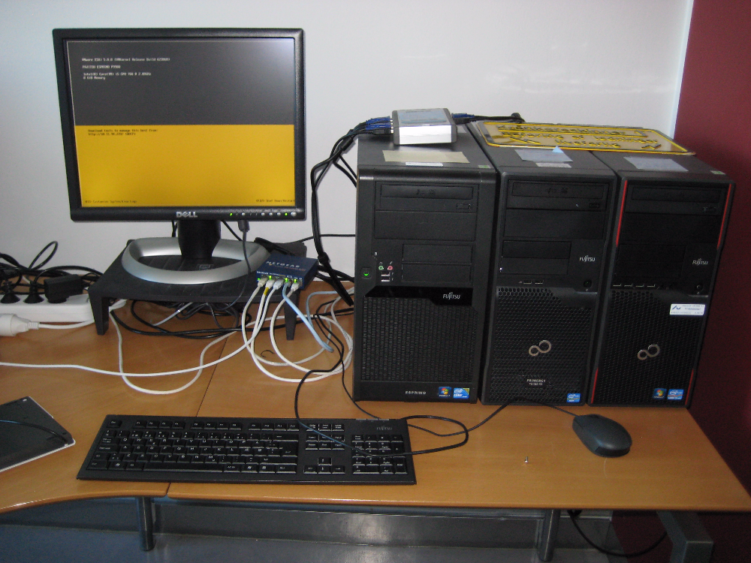
My ‘Private Cloud’ ☺

Slide 22
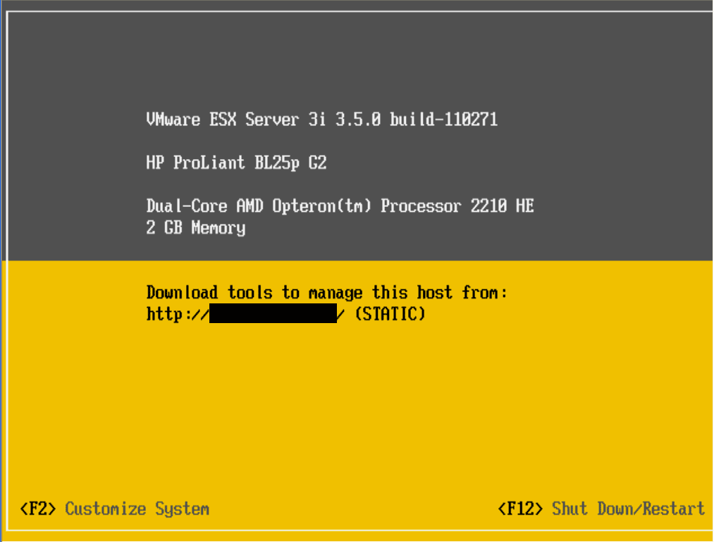
VMWare ESXi
(Linux based) Minimal OS
My ‘Rundo’ runs from the USB stick
… and drivers were hell ☹
Run Mgt application from its web server

Slide 23
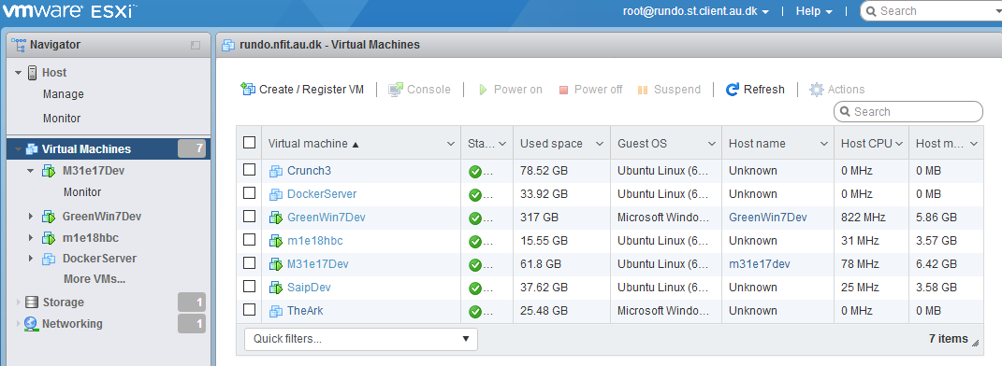
A Small VMM
Remote client to access the VMM

Slide 24
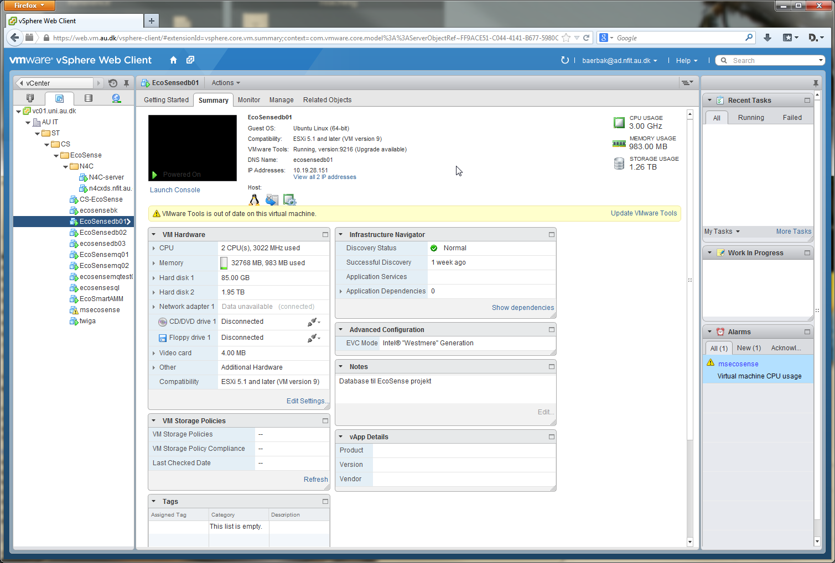
A Much Bigger VMM

Slide 25
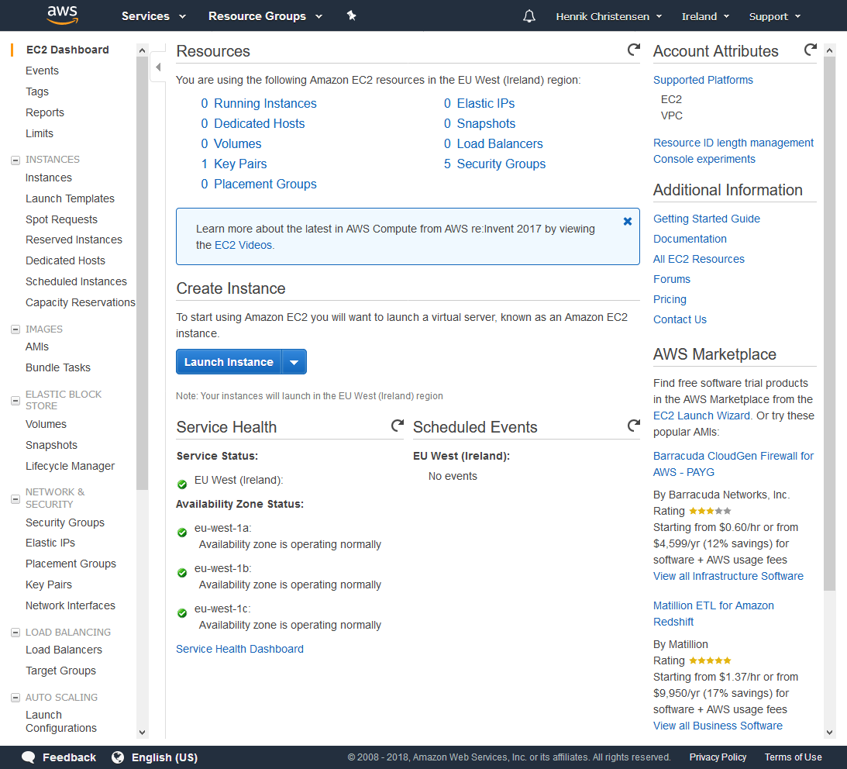
Amazon EC2 Dashboard

Slide 26
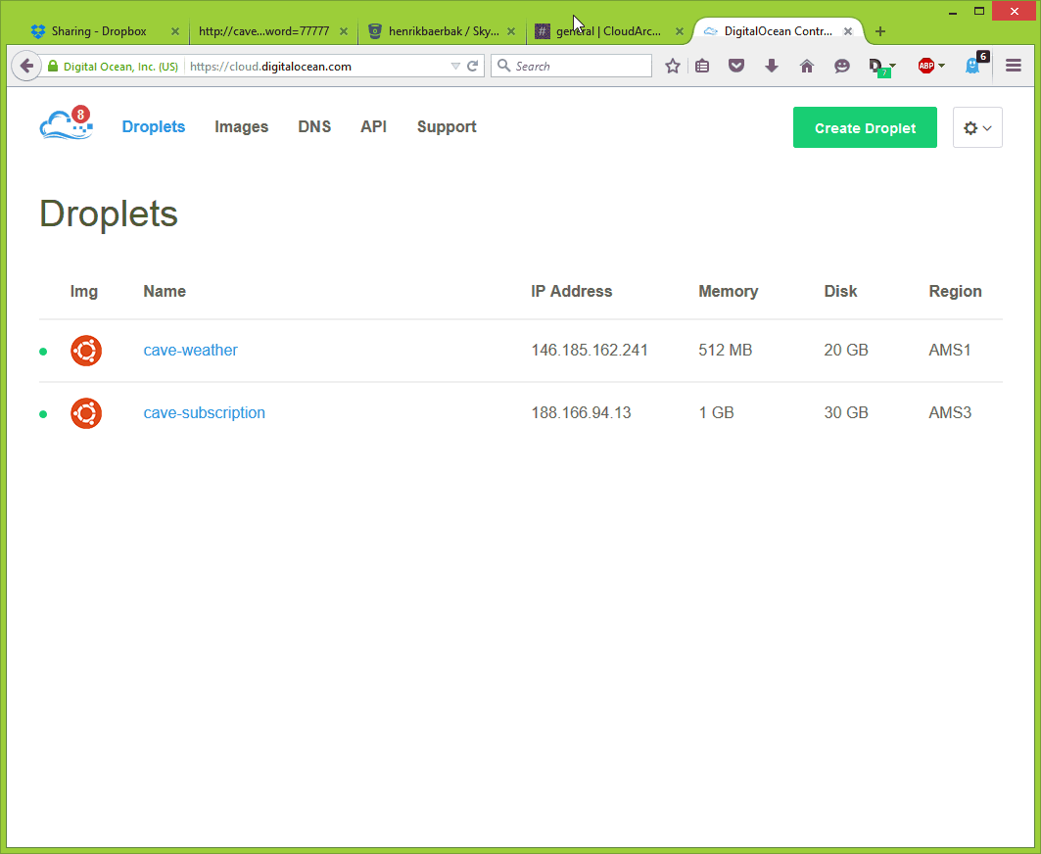
DigitalOcean Dashboard

